Slide 1


Book Recommendation System
Team Members:
1. Hemasri Gajjalasetty
2. Ravi Kumar Sinha
3. Khushi Patre
4. Akanksha
5. Aryan Verma
6. Chandan G.

Slide 2
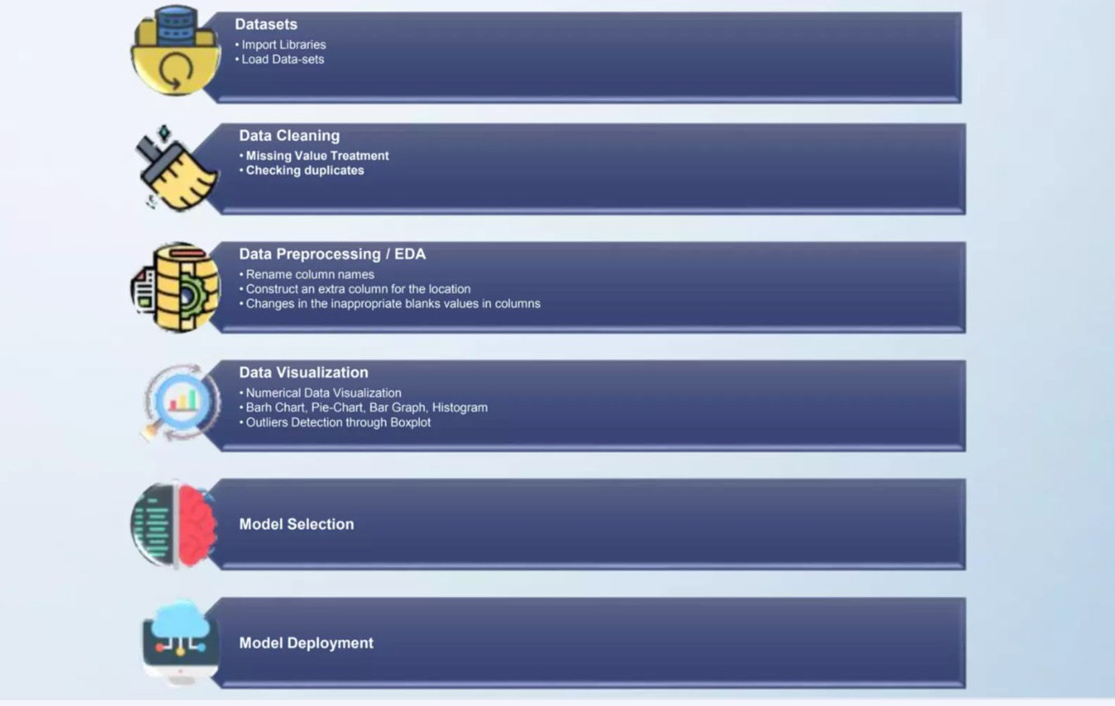
Project Architecture

Slide 3


Introduction to Recommendations System
A recommendation system is a tool used to suggest items like movies, books, or products that you might enjoy, based on your previous preferences or behavior. It works in two main ways: collaborative ﬁltering and content-based ﬁltering. Many popular platforms, such as Netﬂix, Amazon, and Spotify, use recommendation systems to provide a personalized experience.

Slide 4

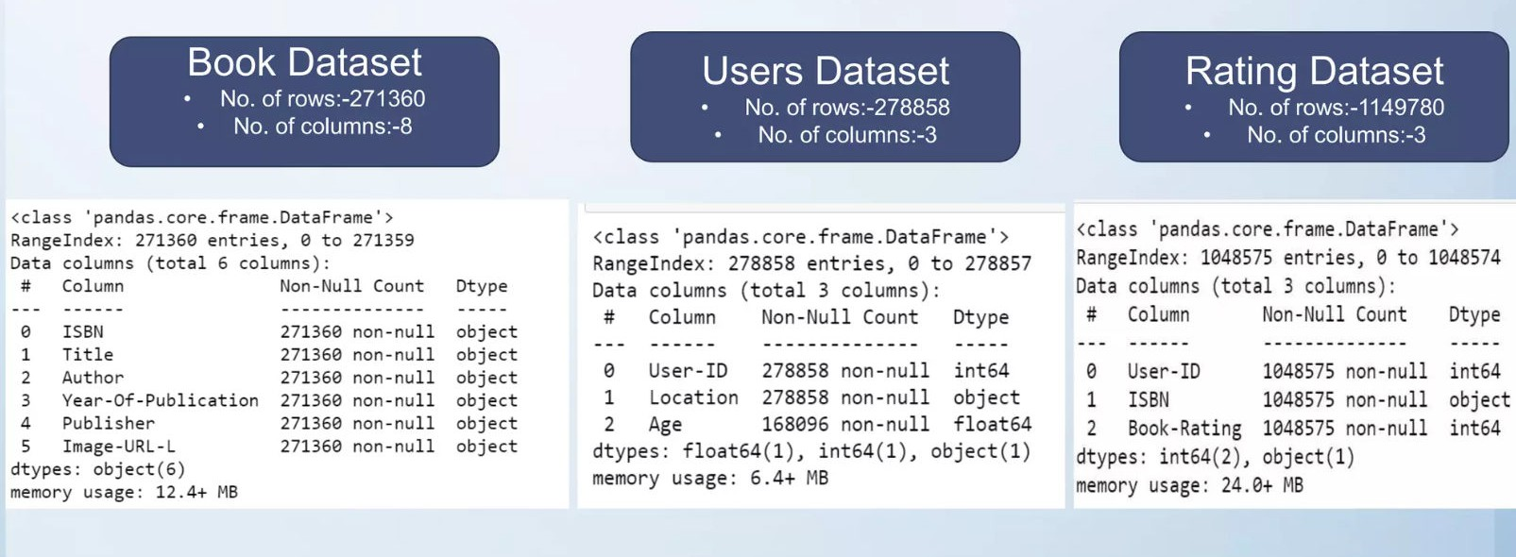
Dataset Details

Slide 5

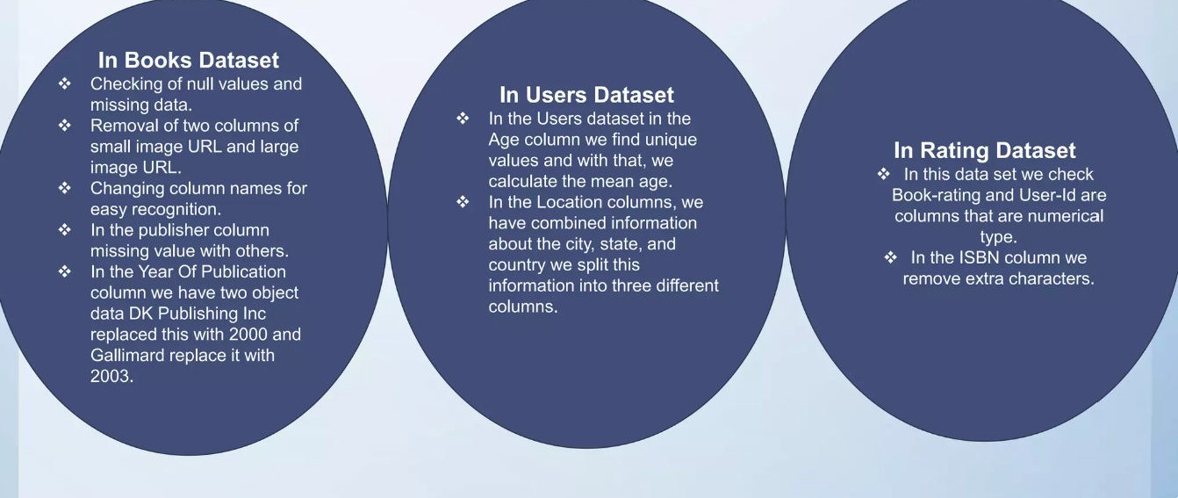
Data Preprocessing

Slide 6

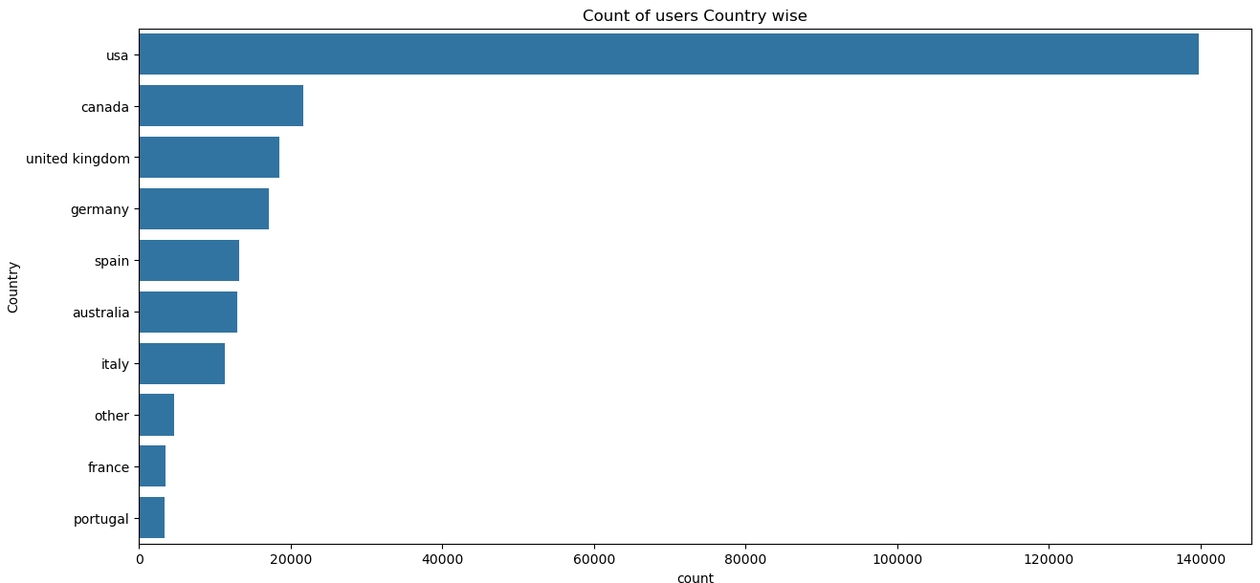
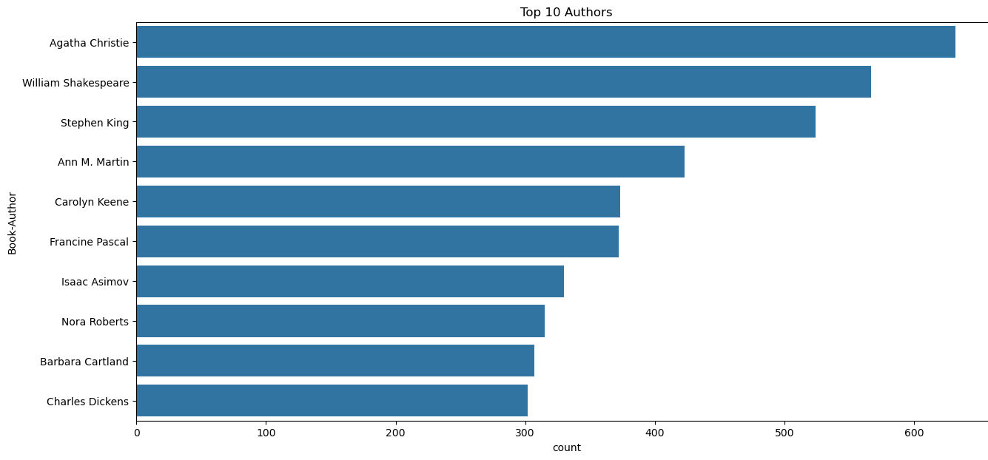
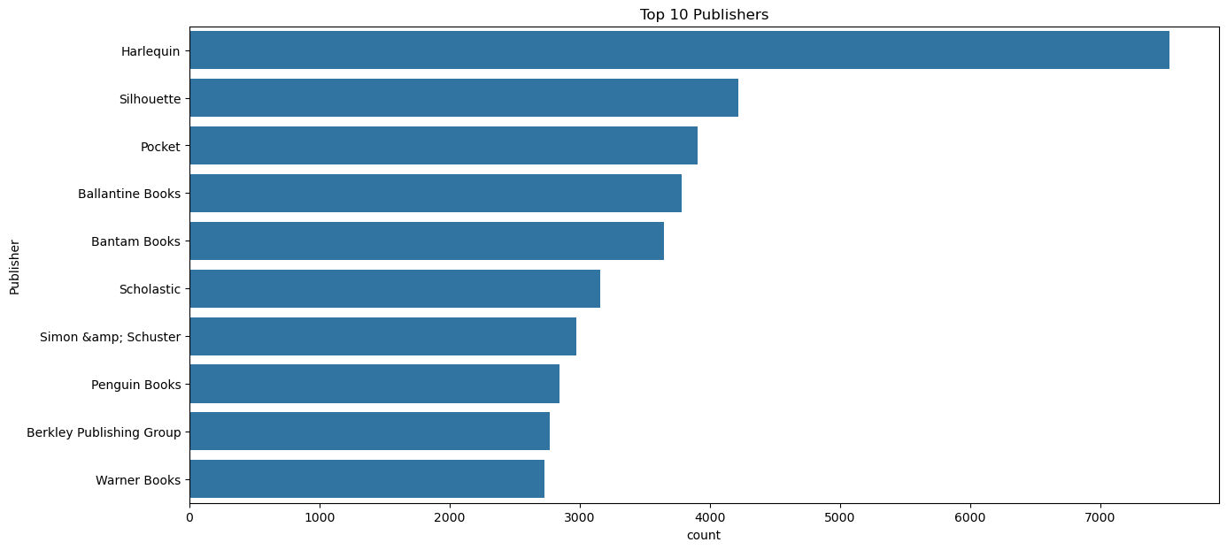
Visualization
Top 10 Authors which have written the most books.
Distribution of Users by Country
Top 10 Publisher which have published the most books.

Slide 7
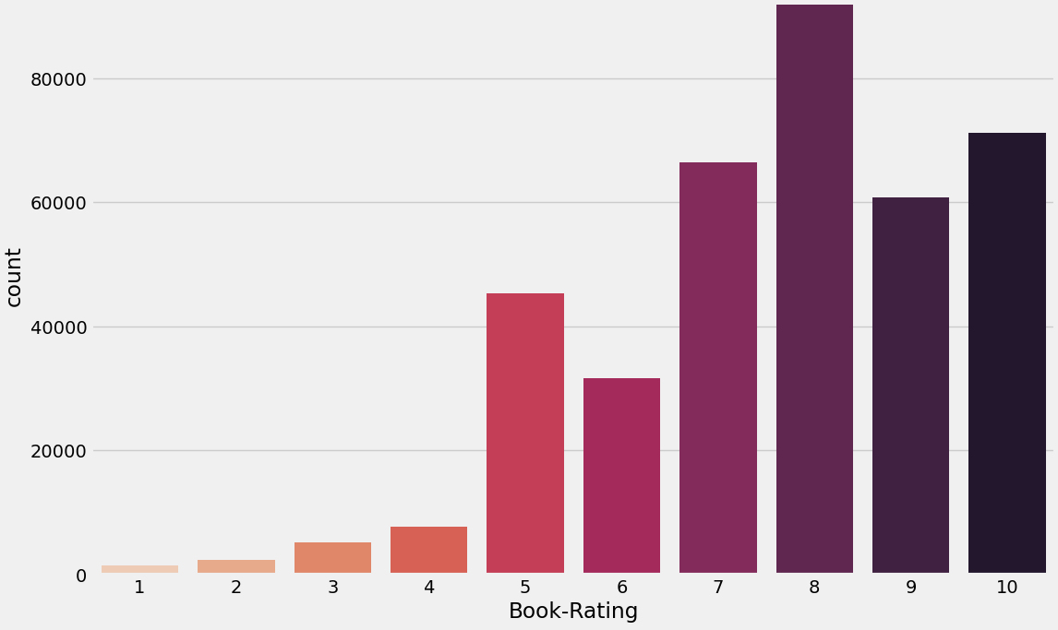
It can be observed that higher ratings are more common amongst users and rating 8 has been rated highest number of times

Slide 8
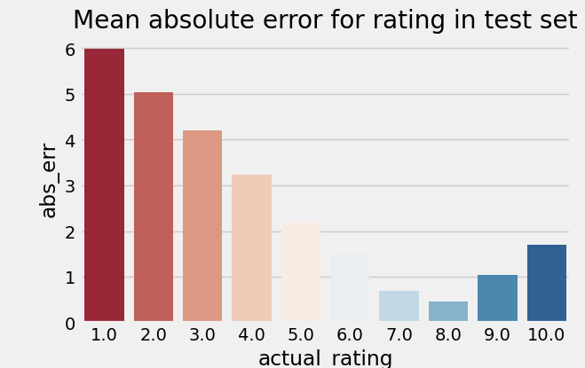
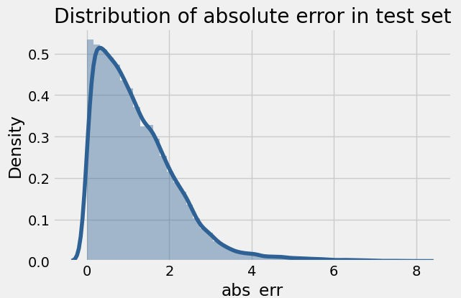
Distribution of actual and predicted ratings in the test set

Slide 9

Recommendation
Technique
Popularity Based Filtering:
As the name suggests Popularity based recommendation system works with the trend. It basically uses the items which are in trend right now.
2. Collaborative Filtering:
Collaborative filtering is a technique used by websites like Amazon, YouTube, and Netflix. It filters out items that a user might like on the basis of reactions of similar users.
There are two categories of collaborative filtering algorithms: memory based and model based.

Slide 10
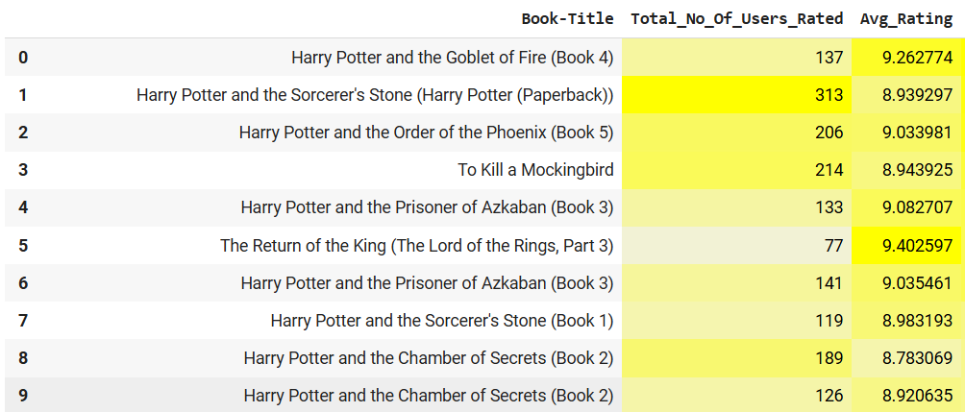
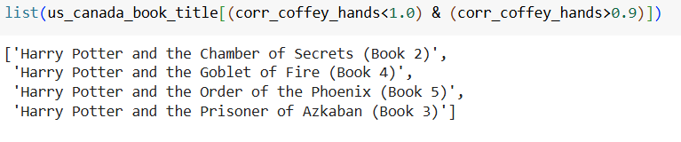
1. Popularity Based Filtering
2. Collaborative Filtering
Popularity based recommendation system Data frame, The top ten books as per ratings
Collaborative Filtering Recommender System- Memory Based- KNN

Slide 11


Deployment
Deployment refers to the process of making a developed project or application available for use in a production environment. It involves transferring the application from the development stage to the live environment where it can be accessed by end-users or clients. This process includes setting up the necessary infrastructure, such as servers, databases, and any other required components, ensuring the project runs smoothly outside of the development environment.

Slide 12
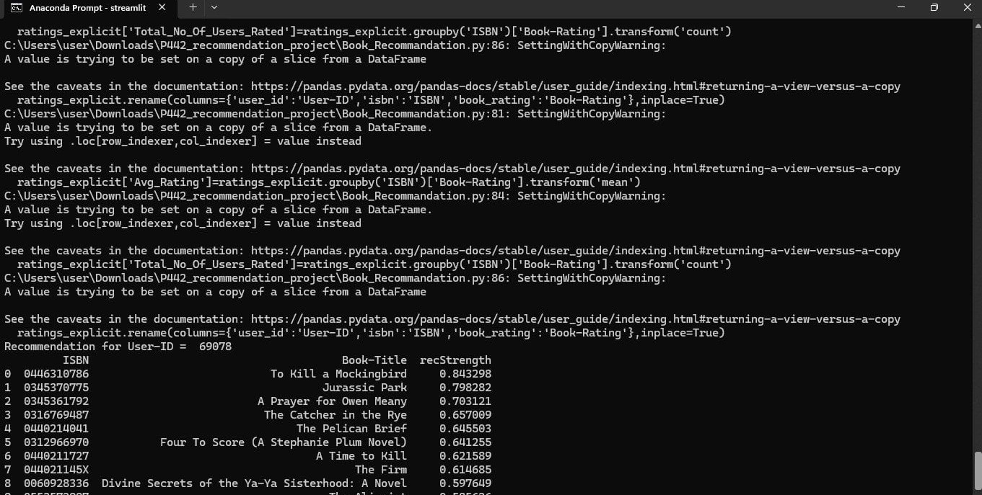

Slide 13




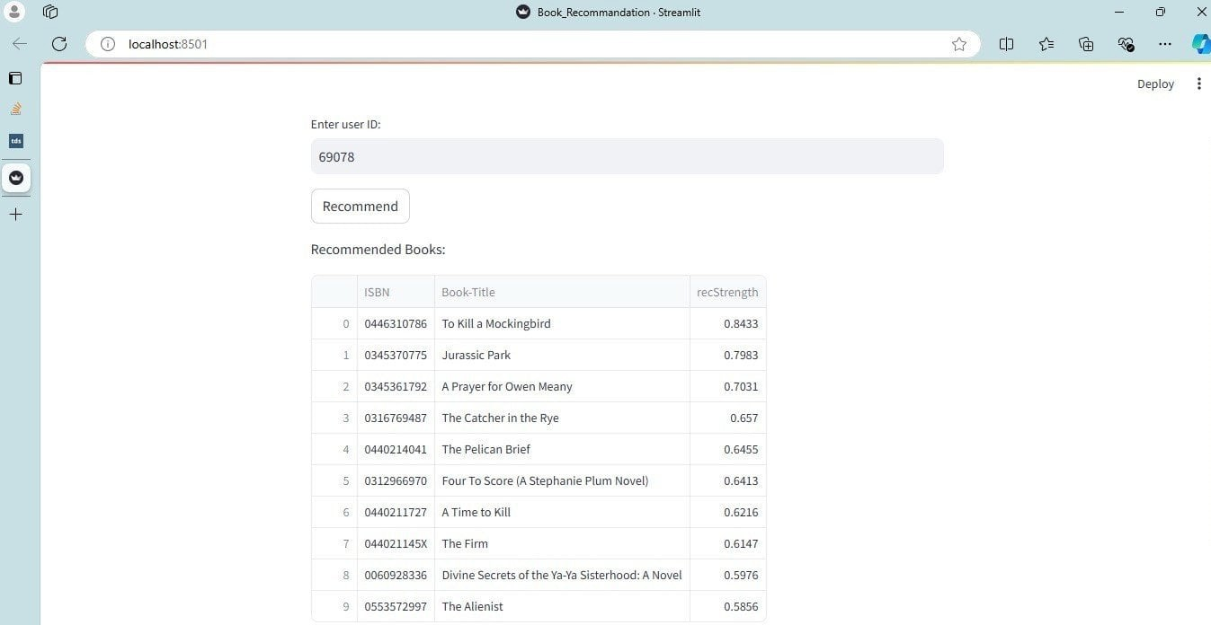

Web Page

Slide 14
Challenges & Difficulties
Data Sparsity: Many users rate only a few books, creating a sparse user-book matrix, which limits model performance.
Cold Start Problem: Difficult to recommend for new users or new books with no prior ratings.
Scalability: As the dataset grows, maintaining fast and accurate recommendations becomes more challenging.
Implicit Feedback: Not all users provide explicit ratings, making it harder to capture true preferences.
Data Imbalance: Popular books receive most ratings, while many books have few or none, leading to uneven recommendations.

Slide 15


